Slide 1
Precision Agriculture
Week 2

Slide 2
Mission Statement
Even if the tremendous effort is deployed by the world to decreases the plant loss and food scarcity, several references [1] [2] confirm that more than 20% of crop losses in global scenario is due to plant diseases.
Unavailability of proper plant disease diagnosis in rural and poor farming areas.
A need for a portable device for plant disease detection on site.

Slide 3
Goals
Designing a portable plant disease detection system using image recognition running on FPGA.
Understanding fundamentals of current image detection algorithms and models.
Training a traditional vertical slice prototype model for plant leaf disease detection.
Acquiring further understanding into low footprint designs to introduce into FPGA.
Running inference model on FPGA.
Training model on FPGA.

Slide 4
Milestones
Fundamentals: Encompass the principals of Convolutional Neural Network (CNN).
Review: Gather data regarding current advancements and ongoing research on image feature detection and applications in plant leaf disease detection.
Tools: Make an educated decision on the framework and tools to use to create a model of the inference machine.
Implementation: Apply model to FPGA device whilst understanding memory and other limitations will steer the implementation.
Evaluation: Iteration and performance evaluation.

Slide 5
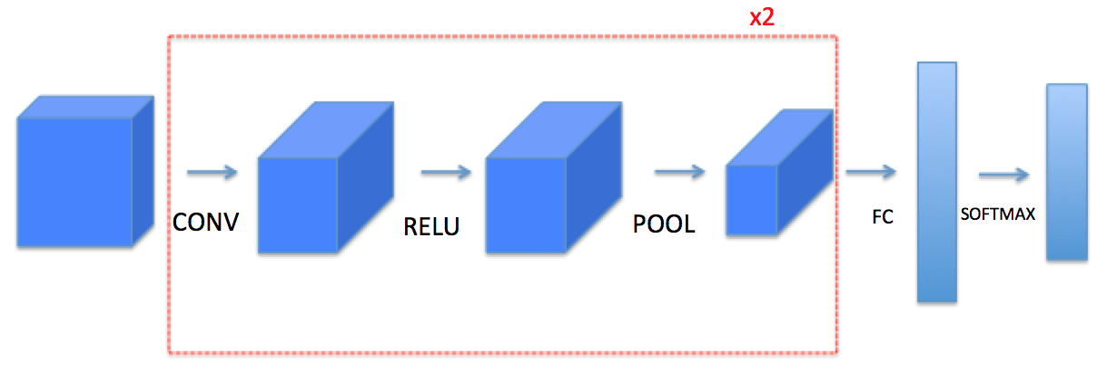
Fundamentals
Usage of CNN for image inference and classification is prominent.
CNNs are a class of deep neural networks, most commonly applied to analyzing visual imagery.
A convolutional neural network consists of an input and an output layer, as well as multiple hidden layers.
As shown in Figure 1 the hidden layer typically consists of connected blocks that filter through the input in order to allow for feature extraction and then classification.
Figure 1 - CNN structure

Slide 6
Convolution Layer
The input images to the system are preprocessed into a tensor form of shape (number of images) x (image height) x (image width) x (image depth) with pixel values for the data.
As shown in Figure 3; convolution between the filter and an image occurs by multiplying their values element-wise, followed by a summation then adding the bias.
Figure 3 - Image (Green), Filter (Yellow), Feature map (Red)

Slide 7
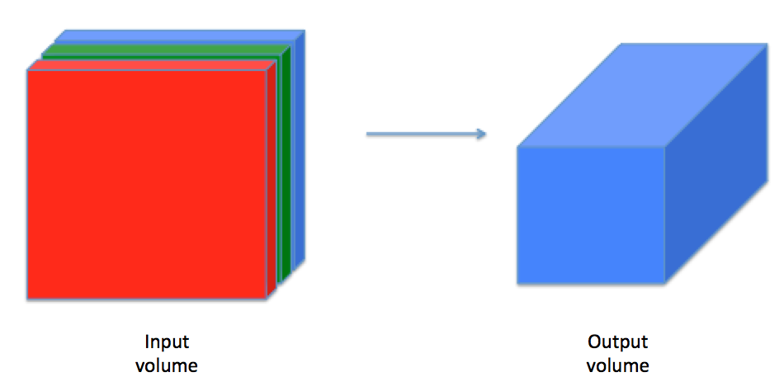
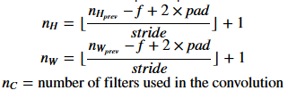
Convolution Cont.
The filter tensor is of shape (filter height) x (filter width) x (image depth) x (number of filters) with the weights for the data.
After the convolution the output is of shape (number of images) x (n_H) x (n_W) x (number of filters) where n_H and n_W are preprocessed values obtained by using Equation 1.
It is important to note that the depth of the output is equal to the number of filters used as shown in Figure 4.
Equation 1 - Preprocessing conv output shape
Figure 4 - Output depth

Slide 8
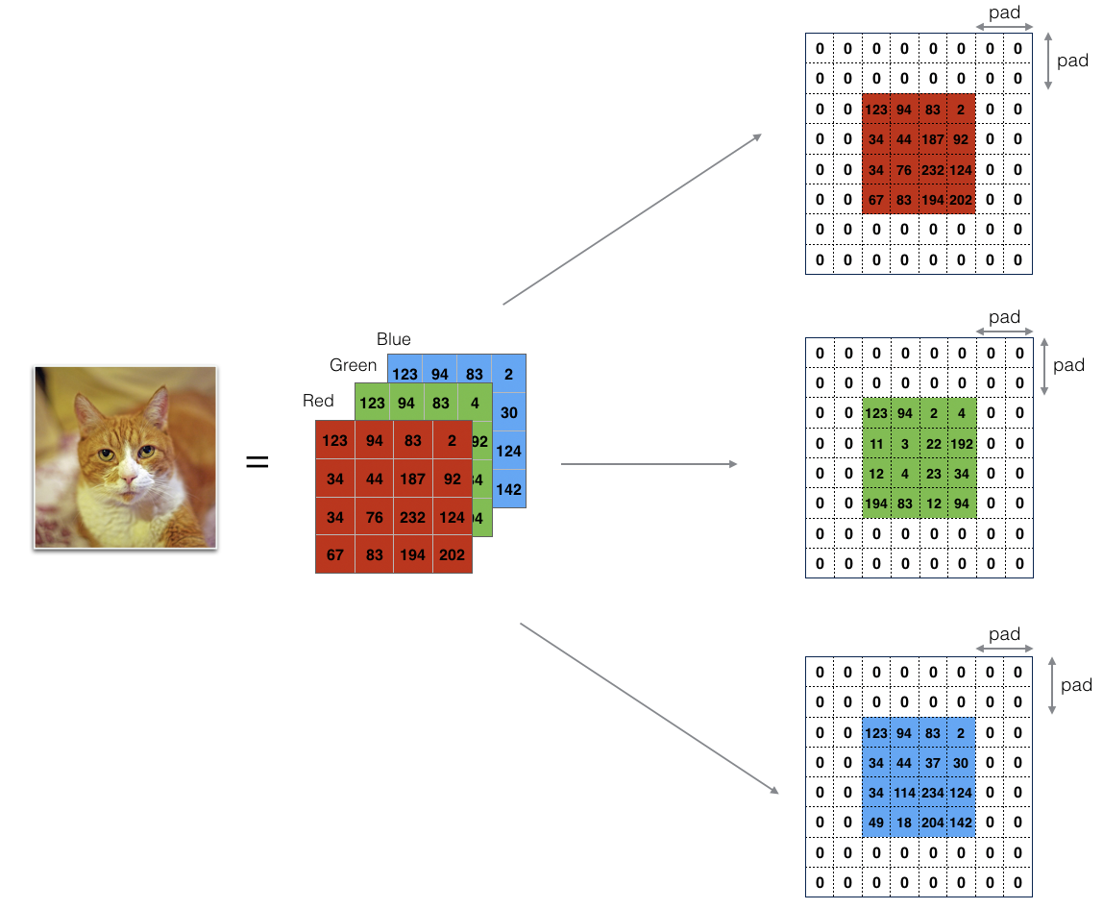
Convolution Hyperparameters
Number of filters (k): Filters are moved across the input in order to extract features (ie. edge detection). As the number of used filters increase a greater feature bandwidth is allowed at the expense of performance.
Spatial extent (filter dimensions): Typically filters are odd dimensions (ie. 3x3, 5x5).
Stride (S): How far the filter will slide on each iteration of the convolution.
Padding: Is used to preserve the output of the convolution. To avoid over shrinkage.
Figure 2 - RGB input with padding of 2

Slide 9
Activation function
ReLU

Slide 10
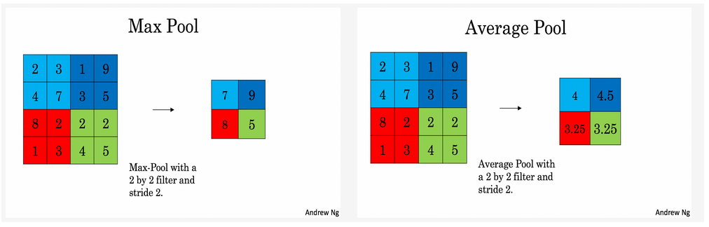
Pooling Layer
Pooling is a form of non-linear downsampling which reduces the height and width of the input which helps reduce computational complexity as well as memory footprint.
Pooling slides a window of shape f x f with a specified stride value as can be seen in Figure 5. Where f and stride are the pooling layer hyperparameters.
Figure 5 - Pooling types

Slide 11
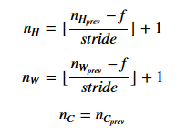
Pooling Cont.
After the pooling the output is of shape (number of images) x (n_H) x (n_W) x (image depth) where n_H and n_W are preprocessed values obtained by using Equation 2.
Equation 2 - Preprocessing pooling output shape

Slide 12
Fully connected layer

Slide 13
Soft Max

Slide 14
Review
The goal into reviewing academic papers are to ensure proper overall understanding going forward.
The main focus points we reviewed are:
Plant disease detection using CNN.
DL FPGA implementations.
FPGA DL acceleration.

Slide 15
Plant disease detection
The aim of this review is to dissect low memory footprint Deep CNN training methods by referencing these papers:
“Tomato Disease Detection and Classification by Deep Learning” - Huiqun Hong et al, College of Artificial Intelligence, China.
“Health Detection for Potato Leaf with Convolutional Neural Network” - Trong-Yen Lee et al, National Taipei University of Technology, Taiwan.
“Identification of Maize Leaf Diseases Using Improved Deep Convolutional Neural Networks” - Xihai Zhang et al, IEEE Member.
“Mobile Platform Implementation of Lightweight Neural Network Model for Plant Disease Detection and Recognition” - Anton Louise P. de Ocampo et al, De La Salle University, Philippines.

Slide 16
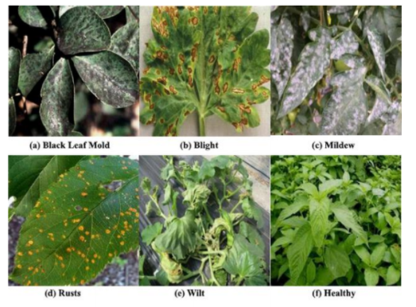
Dataset
Mobile Platform Implementation
The aim of this paper is to carry out general leaf disease detection based on 5 types of common plant diseases. The lightweight MobileNet architecture steered the implementation.
A custom dataset containing 6,970 images was used, the 224 x 224 images were subjected to random augmentations to create different views of the same image, to help in the reduction of overfitting. 63% of the dataset was used for training, 16% for validation and 21% for testing.
An important note to understand about this paper’s dataset is that its diversified. Where as most models are optimized for a specific plant and its diseases, this paper chooses to tackle the most common diseases seen in plants.

Slide 17
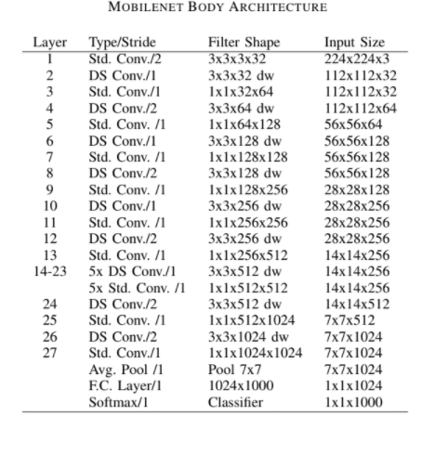
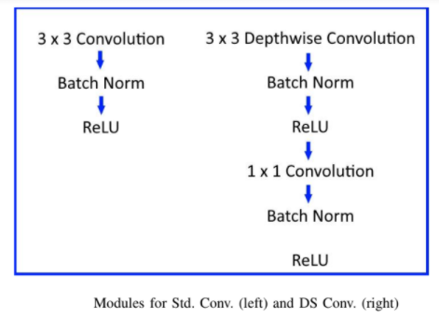
MobileNet
Mobile Platform Implementation
MobileNet is a lightweight architecture that relies on depthwise and pointwise convolutions, to obtain its main pillar; the depth-wise separable convolutional layers. MobileNet has 27 convolutional layers as can be seen by architecture's whole topology in Table X.
Depthwise Separable (DS) convolution uses a depthwise convolution followed by a pointwise convolution. In a addition it introduces two hyperparameters: the width multiplier that thins the number of channels, and the resolution multiplier that reduces the feature maps spatial dimensions. For this paper the width modifier used is 50%. Figure X entails the workflow between standard the Conv. and DS Conv.
The Model’s parameters summed up to 1.3 million which the author declared was relatively smaller than other CNN models.

Slide 18
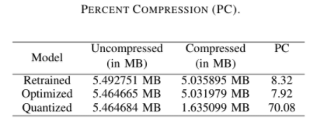
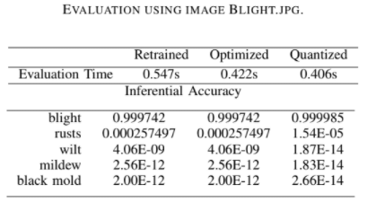
Training and Optimization
Mobile Platform Implementation
This paper leverages the use of transfer learning to reduce the amount of time spent on training their model. The model used in this paper was pre-trained on 60,000 images of different objects including things, persons, plants and animals. This works since in any CNN model, the earlier layers’ filters learn to infer low level features like edges and more abstract shapes. The principles and techniques disclosed in the paper behind retraining the pre-trained model are outlined here.
During the optimization stage, nodes that are not needed by Tensorflow libraries are removed, this reduces the complexity of calculations by merging batch norm operations into the convolutional weights.
Quantization is also utilized where weights are mapped into smaller numbers without changing the architecture or structure of the classifier model.
After these compression methods the data has a much smaller size with the model accuracy being undegraded, as shown in Figure X and X respectively.
The final test accuracy has reached 89% during testing.

Slide 19
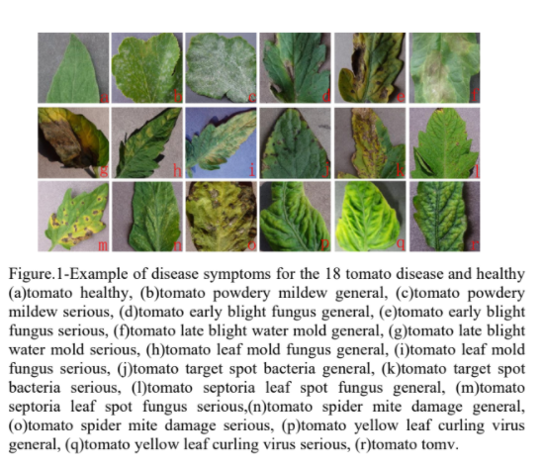
Dataset
Tomato Disease Detection
The aim of this paper is to carry out tomato leaf disease detection based on 9 types of common tomato diseases and as shown in Figure X, the data is has 18 classifications based on stages of disease.
The images were pulled from the open sourced “Plant Village” dataset which contains 13,112 images for tomato leaves.
In order to enhance the model, they introduced image augmentations to their data, which further increased the dataset by 41,263 images.
The images were normalized to a resolution of 224 x 224 with RGB + grayscale color depth.
The dataset was split 80% for training and 20% for validation. This large split was plausible since their dataset was large.

Slide 20
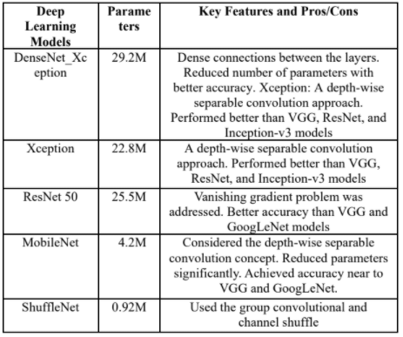
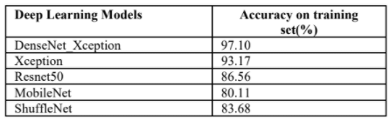
ShuffleNet
Tomato Disease Detection
The paper compared 5 CNN models to try and find the leverage point between accuracy and parameter density.
ShuffleNet architecture is especially designed for mobile devices (ARM chips), thus making it a possible DL model to spearhead this project. This lightweight model carries out depthwise and pointwise group convolution and channel shuffle, to greatly reduce computation cost while maintaining accuracy. And as can be seen in Figure X, the parameter size is greatly reduced compared to other models.
While at the same time, the accuracy is maintained, as shown in Figure X. Compared to MobileNet which is also leveraging the same two variables as ShuffleNet, the comparable size to accuracy difference is worth going deeper into implementations of ShuffleNet on FPGAs.

Slide 21
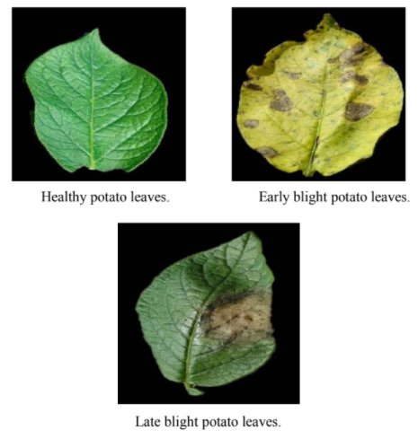
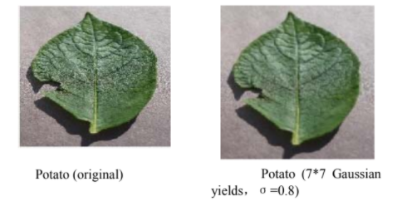
Dataset
Health Detection for Potato Leaf
The aim of this paper is to carry out potato leaf detection based on 2 types of fungal diseases that are common amongst potatoes as shown in Figure X, the size of the paper is small. However, that does not reduce the accuracy of the model since the preprocessing done to the dataset is extensive.
Firstly, a Gaussian filter is applied to the images to normalize blur as displayed in Figure X.

Slide 22
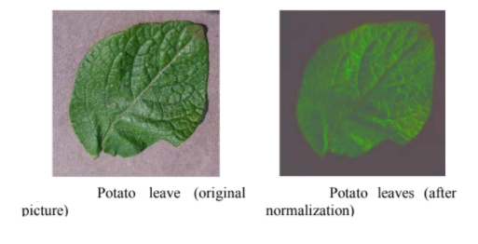

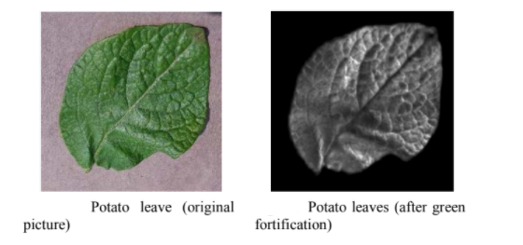
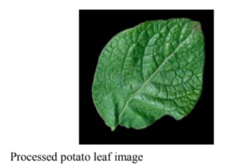
Dataset Cont.
Health Detection for Potato Leaf
Then the RGB channels of the dataset are normalized to reduce the effect of lighting and shadow on the image, shown in Fig. X, by using Equation X.
After that, the paper is slightly ambiguous on this step where the green region of interest is inverted, parts of the image that is not green will turn black.
Then lastly the paper reintroduces the original image Fig. X, to have a final output of Fig. X.

Slide 23
FPGA Implementation
The aim of this review is to dive deep into implementations of CNN on FPGAs by referencing these papers:

Slide 24
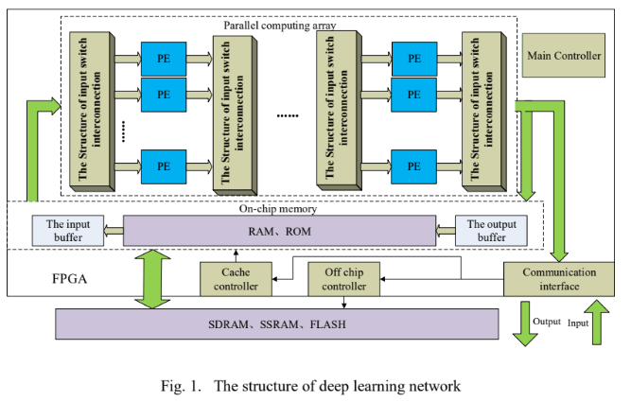
Paper title

Slide 25
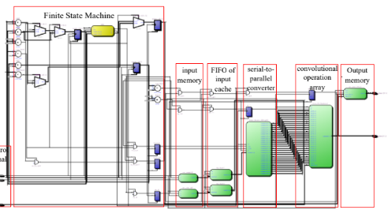

Slide 26
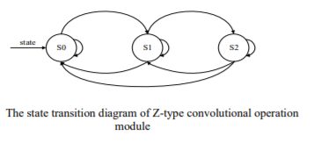

Slide 27
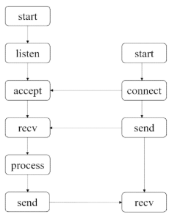

Slide 28
FPGA-Based Reduction Techniques for Efficient Deep Neural Network Deployment
This paper mainly focus on the reduce complexity and to efficiently deploy deep networks in an embedded FPGA-based setting with strict power and area budget.
By applying both:
fixed-point quantization and low-rank weight approximation.

Slide 29
Reduction Techniques
1) Fixed-Point Quantization:
Instead of using high-precision floating-point representations of convolutional weights, we look to utilize only low precision, fixed-point representations. Utilizing lower-precision weights with stochastic rounding has previously been shown to improve classification accuracy by acting as a form of regularization. We look to further exploit this to significantly reduce power and area.

Slide 30
Reduction Techniques
2) Singular Value Decomposition:
Given a fully-connected layer with N neurons and M inputs, the weight matrix WM,N can be factorized as UM,NΣN,NVT N,N, where U and V are unitary matrices and Σ is a rectangular diagonal matrix containing singular values. If the weight matrix is sparse, then we can keep only the K largest singular values. When K N, this can be approximated as UM,K ΣK,KVT N,K = UM,KV K,N.

Slide 31
Reduction Evaluation
By two reduction techniques were applied to three popular computer vision datasets:
MNIST, CIFAR, and SVHN.

Slide 32
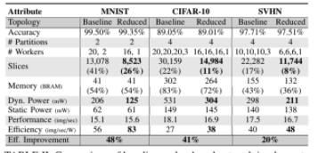

Slide 33
Results of Reduction
When running on an Xilinx Artix-7 FPGA, experimental results demonstrated the ability to achieve a classification throughput of 16 images/sec and consume less than 700 mW at 200 MHz when applied to three popular computer vision datasets. In addition, the reduced networks are able to, on average, reduce power and area utilization by 37% and 44%, respectively, while only incurring less than 0.20% decrease in accuracy.

Slide 34
Implementation of Data-optimized FPGA-based
Accelerator for Convolutional Neural Network
LeNet-5 CNN architecture for MNIST handwritten digit recognition. The accelerator is synthesized with Xilinx Vivado High-Level Synthesis (HLS) tool (v2017.2), targeting xczu9eg-ffvb1156-2-i FPGA board. The proposed accelerator focuses on reducing latency and memory usage, and the performance is compared with a conventional floating point design.Our proposed accelerator can achieve latency reduction up to 90% and memory usage reduction up to 40% without any accuracy loss, compared to the conventional design.

Slide 35
Why we are going to use CNN on Embedded FPGA ?
Convolutional Neural networks (CNNs) are widely used in various applications such as image classification, for their high classification accuracy. For their implementation FPGAs are considered as suitable platform for CNNs due to their low power consumption and reconfigurability.

Slide 36
LeNet-5 Architecture
LeNet-5 architecture consists of three convolution layers (C1, C3, and C5), two subsampling layers (S2, S4), one fully connected layer (F6), and an output layer.The network uses 32-bit floating point data for input and parameters. It receives 32x32 input image from MNIST handwritten digit dataset for classification. Subsampling layers perform average pooling with 2x2 filter, and each layer uses tanh activation function, setting output range to [-1, 1].

Slide 37
Conclusion
we found that the minimal bit width we can use to achieve zero accuracy loss is 20 bits, with 1 sign bit, 5 integer bits, and 14 decimal bits. Further reducing the length of integer bits or decimal bits resulted in accuracy loss. While further reducing data bit width can result in better performance, we wanted to keep zero loss in accuracy for the accelerator.

Slide 38
Our Challenge
CNNs however require large computations and resource. To fit small hardware,CNN accelerators need to be optimized to reduce memory size,resource usage, and power consumption. Many researches have been conducted to implement more efficient high-performance CNN accelerators on FPGA platforms.

